Slide 1
Soft Clustering

Slide 2
Soft Clustering
So far, clustering was done using hard assignments (1 point -> 1 cluster)
Sometimes this doesn’t accurately represent the data: it seems reasonable to have overlapping clusters.
In this case, we can use soft assignment to assign points to every cluster with a certain probability.

Slide 3
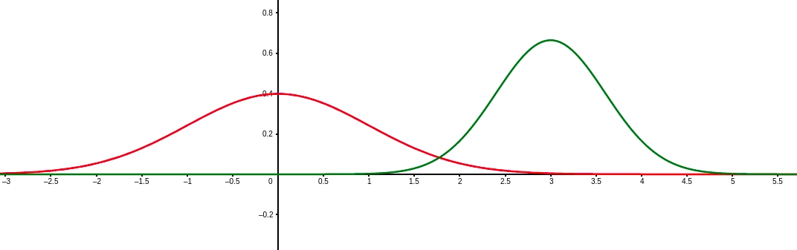
Soft Clustering - Example
Generate data using N(𝝻₁, 𝞂₁) and N(𝝻₂, 𝞂₂)
Or: we are given the weights of animals. Unknown to us these are weights from two different species.
Can we determine the species (group / assignment) from the height?

Slide 4
Soft Clustering - Example
Generate data using N(𝝻₁, 𝞂₁) and N(𝝻₂, 𝞂₂)

Slide 5
Soft Clustering - Example
Generate data using N(𝝻₁, 𝞂₁) and N(𝝻₂, 𝞂₂)
Any of these points could technically have been generated from either curve.

Slide 6
Soft Clustering - Example
Generate data using N(𝝻₁, 𝞂₁) and N(𝝻₂, 𝞂₂)
For each point we can compute the probability of it being generated from either curve

Slide 7
Soft Clustering - Example
Generate data using N(𝝻₁, 𝞂₁) and N(𝝻₂, 𝞂₂)
We can create soft assignments based on these probabilities.

Slide 8
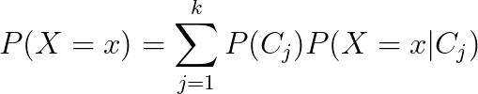
Mixture Model
X comes from a mixture model with k mixture components if the probability distribution of X is:
Mixture proportion
Represents the probability of belonging to C_{j}
Probability of seeing x when sampling from C_{j}

Slide 9
Example
What is the probability distribution here?

Slide 10
Example

Slide 11
Example

Slide 12
Gaussian Mixture Model
A Gaussian Mixture Model (GMM) is a mixture model where

Slide 13
GMM Clustering
Goal: Find the GMM that maximizes the probability of seeing the data we have.
Finding the GMM means finding the parameters that uniquely characterize it. What are these parameters?
P(C_{i}) & 𝝻_{i} & 𝞂_{i} for all k components.

Slide 14
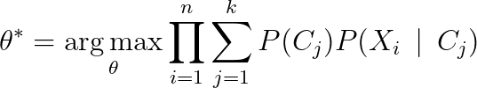
GMM Clustering
Goal:
Where Θ = {𝝻₁, …, 𝝻_{k} , 𝞂₁, …, 𝞂_{k}, P(C₁), ..., P(C_{k})}
Joint probability distribution of our data
Assuming our data are independent

Slide 15
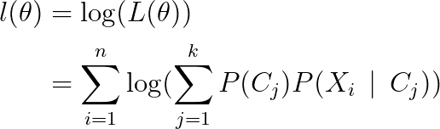
GMM Clustering
How do we find the critical points of this function?
Notice: taking the log-transform does not change the critical points
Define:

Slide 16


GMM Clustering
For 𝝻 = [𝝻₁, …, 𝝻_{k}]^{T} and 𝝨 = [𝝨₁, …, 𝝨_{k}]^{T}
We can solve

Slide 17



GMM Clustering
To get

Slide 18
GMM Clustering
Do we have everything we need to solve this?
Still need P(C_{j} | X_{i}) (i.e. the probability that X_{i} was drawn from C_{j})

Slide 19
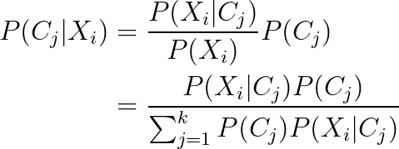
GMM Clustering
Looks like a loop! Seems we need P(C_{j}) to get P(C_{j} | X_{i}) and P(C_{j} | X_{i}) to get P(C_{j})

Slide 20
Expectation Maximization Algorithm
Start with random θ
Compute P(C_{j} | X_{I}) for all X_{i} by using θ
Compute / Update θ from P(C_{j} | X_{I})
Repeat 2 & 3 until convergence

Slide 21
Demo

